Slide 1
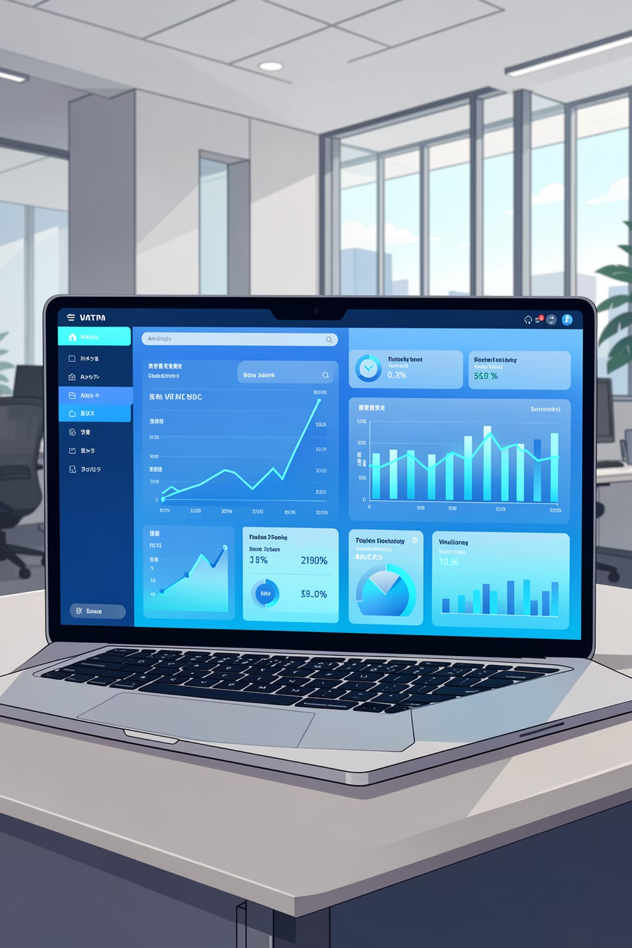
Customer Shopping Behavior Analysis
Analysis of 3,900 purchases to reveal spending patterns, segments, product preferences, and subscription behavior to guide strategic decisions.

Slide 2




Dataset Summary
Customer Demographics
Purchase Details
Shopping Behavior
Missing Data
37 missing values in Review Rating column
Item, Category, Amount, Season, Size, Color
Discount applied, Promo code, Frequency, Previous purchases, Review rating, Shipping
Age, Gender, Location, Subscription Status

Slide 3
Exploratory Data Analysis (Python)
Data Loading & Exploration
Missing Data Handling
Column Standardization
Feature Engineering
Imported with pandas; used df.info() and .describe() for structure and stats.
Imputed Review Rating missing values using category median.
Renamed columns to snake_case for readability and docs.
Created age_group and purchase_frequency_days columns.
Data Consistency
Database Integration
Checked redundancy; dropped promo_code_used as duplicate of discount_applied.
Loaded cleaned DataFrame into PostgreSQL for SQL analysis.

Slide 4
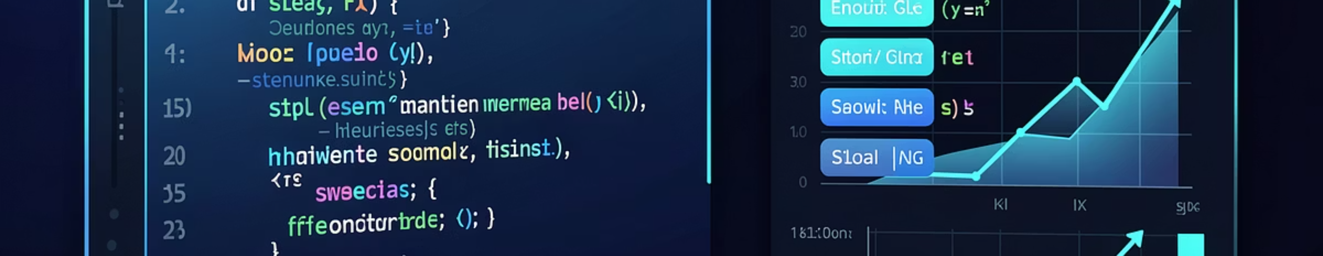
SQL Analysis — Business Transactions
PostgreSQL queries answered core business questions: revenue by groups, discount behavior, top products, shipping comparisons, and segmentation.

Slide 5
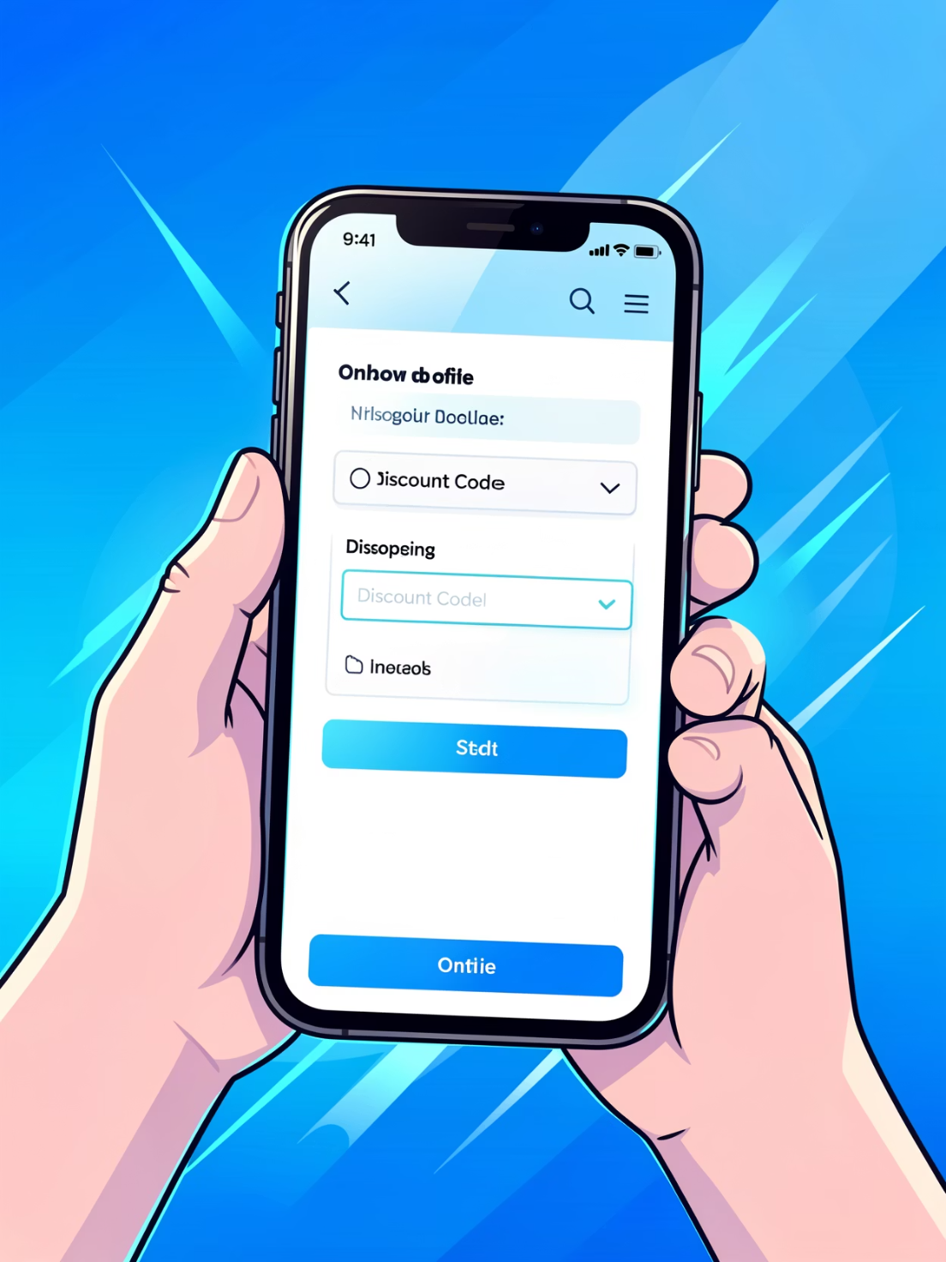
Discounts & High-Spending Users
Identified customers who used discounts but spent above average. Also flagged top products with highest discounted purchase percentages.
Action
Review discount policy to balance sales lift with margins.

Slide 6


Top-Rated & Best-Selling Products
Top 5 products by average rating and top 3 products per category identified for promotional prioritization.
Top Rated
Category Winners
Highlighted in campaigns to drive conversions.
Top 3 per category surfaced for merchandising.

Slide 7
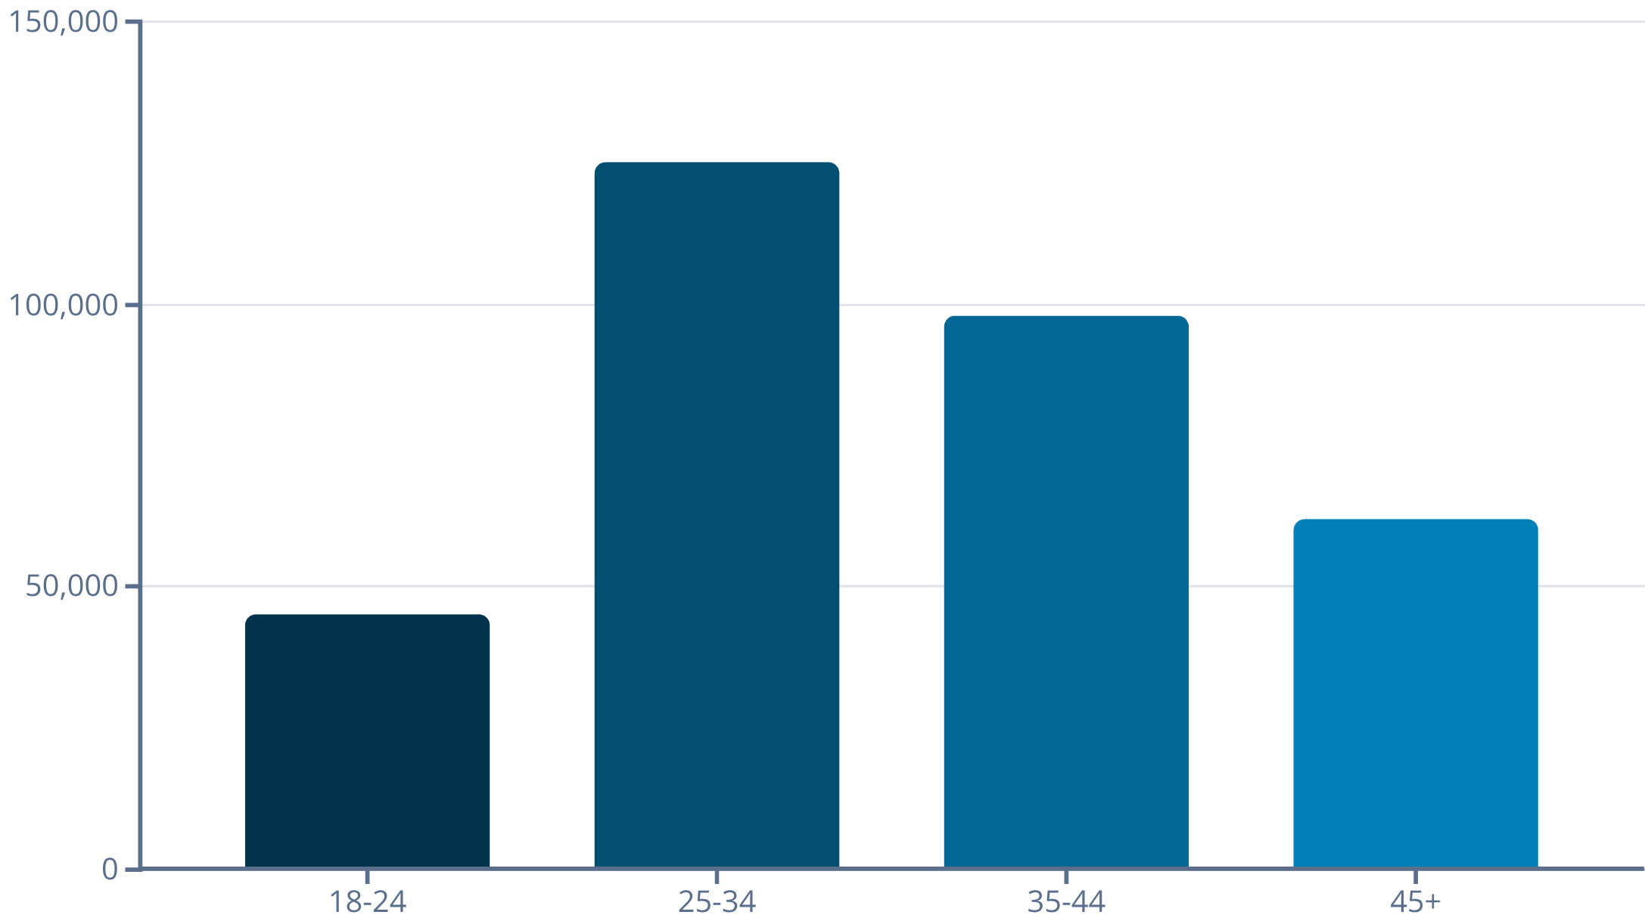
Revenue by Age Group
Calculated total revenue contribution per age group to prioritize targeted marketing toward high-revenue cohorts.

Slide 8
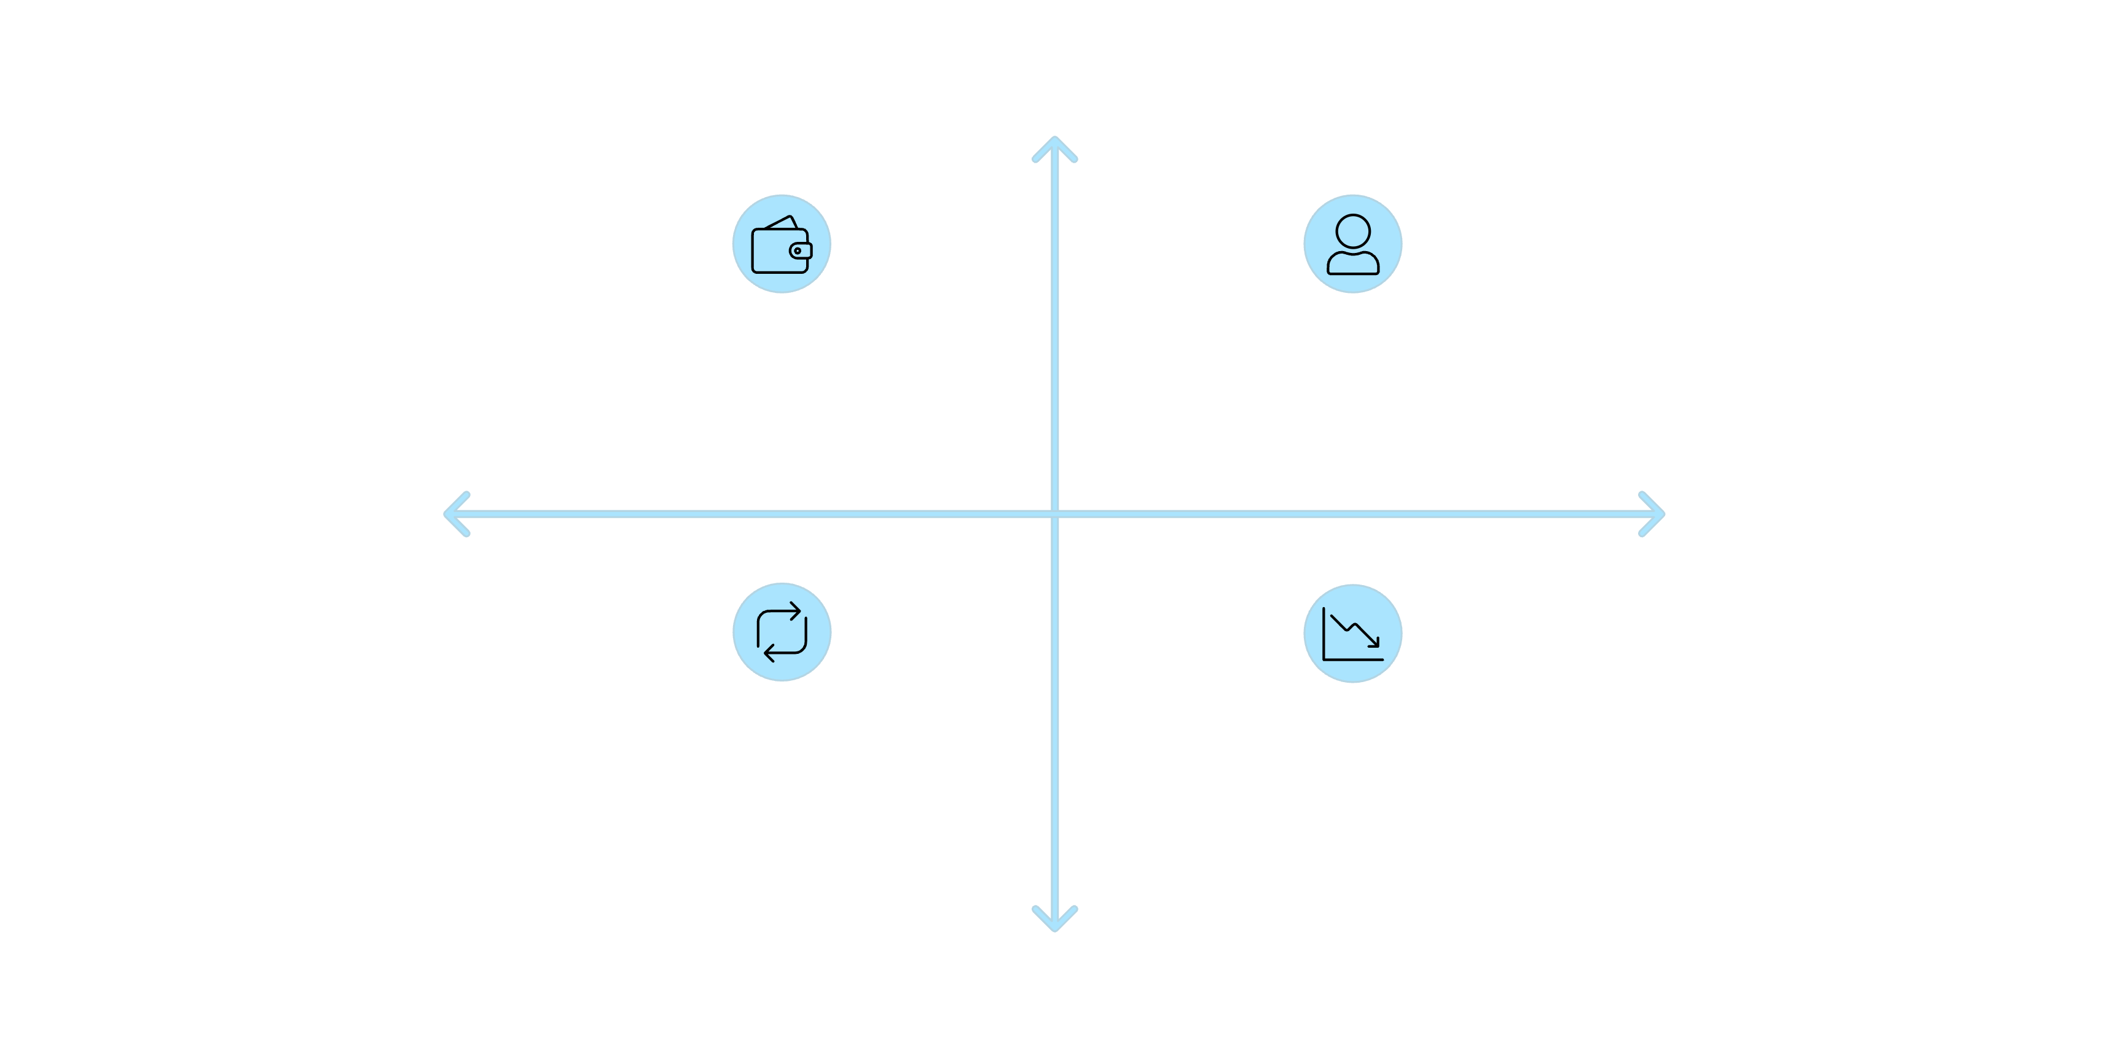




Higher Average Spend
High Avg Spend, Low Conversion
High Avg Spend, High Conversion
Less Likely to Subscribe
More Likely to Subscribe
Low Avg Spend, High Conversion
Low Avg Spend, Low Conversion
Lower Average Spend
Diagram contrasts subscribers and non-subscribers on average spend and revenue, and examines whether repeat buyers (>5 purchases) are likelier to subscribe.

Slide 9
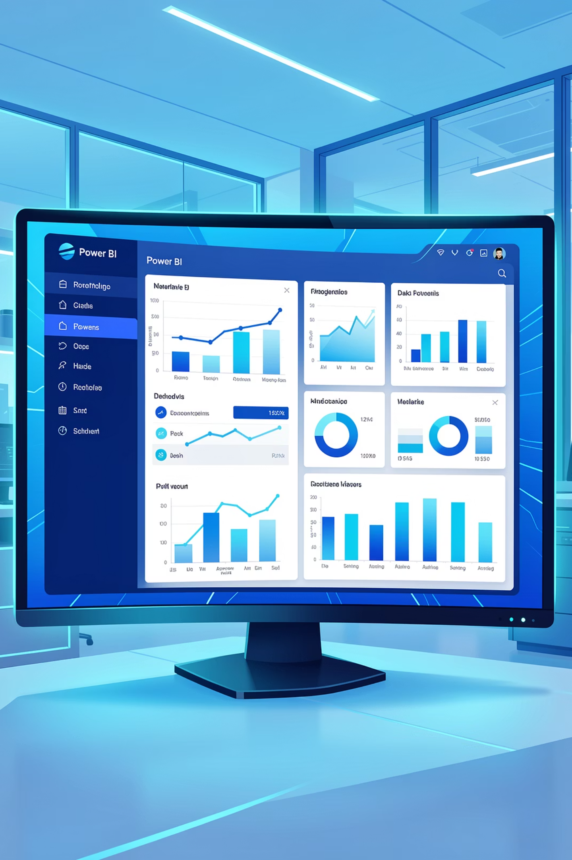
Interactive Dashboard (Power BI)
Built an interactive Power BI dashboard to visualize insights: revenue by segment, shipping comparisons, repeat purchase behavior, and product performance.

Slide 10
Business Recommendations
Boost Subscriptions
Customer Loyalty Programs
Review Discount Policy
Product Positioning
Promote exclusive subscriber benefits to increase revenue and retention.
Reward repeat buyers to move them into the Loyal segment.
Balance sales lift from discounts with margin protection.
Feature top-rated and best-selling products in campaigns.
Targeted Marketing
Focus efforts on high-revenue age groups and express-shipping users.

